Slide 1

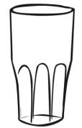


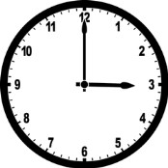






EYFS Maths Knowledge Mat
Recognise and order numbers to 20
1
2
3
4
5
6
7
8
9
10
11
12
13
14
15
16
17
18
19
20
Number bonds to 5
1 | 2 | 3 | 4 | 5
0 + 1 | 0 + 2 | 0 + 3 | 0 + 4 | 0 + 5
 | 1 + 1 | 1 + 2 | 1 + 3 | 1 + 4
 |  |  | 2 + 2 | 2 + 3
Quantity To 10
1 |  | 6
2 |  | 7
3 |  | 8
4 |  | 9
5 |  | 10
Adding and subtracting
Add two single digit numbers Subtract a single digit number from another Say one more/one fewer than a given number
Capacity
Empty | Half Full | Full
Time
 | O’clock The hour hand points to the time and the minute hand points to 12.
Shapes including:
circle
triangle
square
rectangle
Days of the Week (in discussion)
Monday
Tuesday
Wednesday
Thursday
Friday
Saturday
Sunday
Number | Double
0 | 0
1 | 2
2 | 4
3 | 6
4 | 8
5 | 10
Weight
Heavy / Heavier / Heaviest
Light / Lighter / Lightest
Balanced / Equal
Pattern
Colour |  | blue, red, blue, red
Size |  | big, small, big, small
Length |  | long, short, long, short
Number | Half
0 | 0
2 | 1
4 | 2
6 | 3
8 | 4
10 | 5

